Slide 1
Big Rocks
Orange student video
LIM in Action!
Let’s Celebrate!
What celebrations have you seen through kids, staff, parents, community?
Share success stories!
School Mission
Inspiring a community of life long learners and leaders!
Personal Mission/word

Slide 2
Habit 2: Begin with the end in mind
Personal Mission Statement/Word
Notes:
Brainstorm “When you think of ‘Begin with the end in mind,’ what do you think of? Just shout out-at this time have a lovely assistant write on a poster of what comes to mind when ppl think of habit 2-When done find a way to wrap it all up to the end in mind for this professional development.

Slide 3
What are the Benefits of a Personal Mission Statement?
Clarifies what is important to you.
Provides focus.
Helps you design your life instead of having it designed for you.
Guides your day-to-day decisions.
Gives you a greater sense of meaning and purpose.
“A sailboat without a keel and rudder will be blown wherever the winds and tides direct.” ~Dr. Lee Jampolsky
Notes:
Can I see a show of hands for those of you who already have a personal mission statement. Perhaps you made one last year when we did this and you are still using it to this day? Can I see a show of hands for those of you who have life insurance? Last year I referred to life insurance and how more people raise their hands that they have life insurance but not a mission statement. Most people are more prepared to die than they are to live.
If you look at this quote below from “A sailboat without a keel and rudder will be blown wherever the winds and tides direct.” Your purpose and mission statement are the ‘keel and rudder’ Without a stated purpose, the winds of life can easily blow you where they will. You may end up feeling like you have few choices, or worse, feeling like a victim.

Slide 4
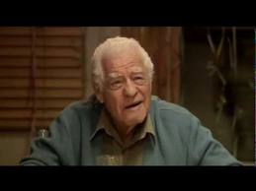
80th Birthday
Notes:
6:43 Our goal by the end of the this time together is to find a purpose so that those winds can lead us in the direction that we want to go. Let’s fast forward a little and think about when we turn 80. The way that you live your life is your choice, but your choice often effects those around you. As you are watching this video, envision yourself on your 80th birthday and what you want people to say about you and what you have been known for during your lifetime.

Slide 5
Role 1: Significant other
Key person:
Justin
Show/give unconditional love-cooking, cleaning, etc.
Be intentional with the time we have together-go on more dates
Role 2: Friend
Key Person:
Making time for them
Be intentional of time together
Someone they can rely/count on
Role 3: Daughter
Key Person:
Mom, Dad
Unconditional love
Check in often-How are THEY doing?
Spend intentional time together-take the time to drive to Decorah randomly
Roles and Relationships
Tribute Statements
Notes:
Turn to page __ in your brown book. You may have done these at an earlier point, but let’s look at them again. Take a couple of minutes and think of 2-3 roles you have in your life. For example, I play the role of a significant other, friend, and daughter. Now think about what how you want that person/people to describe you. Feel free to write them down, or if you already have this done then edit/add to your key roles and tribute statements.

Slide 6
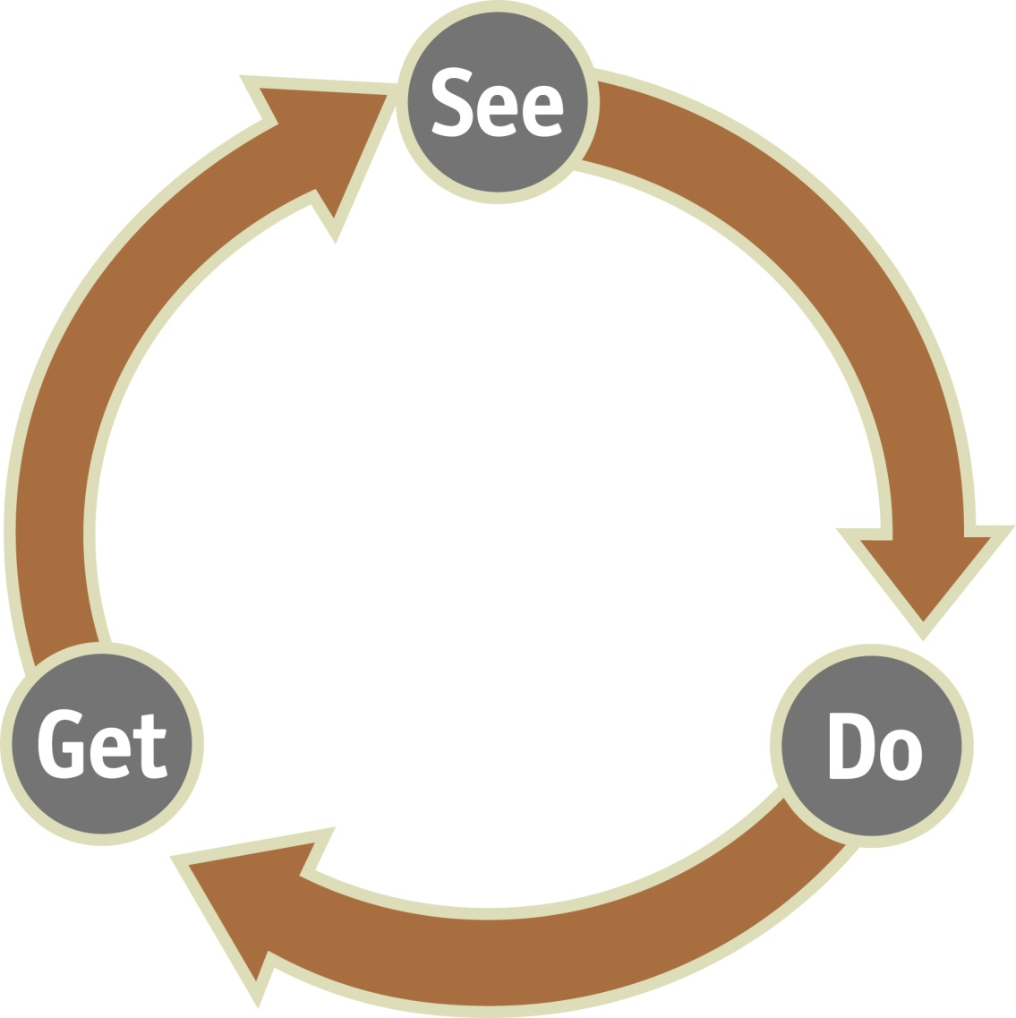
Paradigm
Mental creation precedes physical creation.
Result
Behavior
Notes:
Paradigm is that I live by design not default. Once you realize that you live by design and you are the creator of your own life/future you can think and envision outcomes before you act; therefore you can choose the correct behavior or personal mission statement. If you can see it and it is a MENTAL CREATION then you will get results that are more physical and easily seen.

Slide 7
What does a personal Mission Statement look like?
You have a purpose in life. You know in your heart what’s most important to you. In fact your mission and values are expressed every day-by how you live.
Your own creation made up of values and beliefs.
Quotes
Phrases
Poems
Prayers
Notes:
Quotes- This is not my mission statement, but I’m sure that some of you have heard me say this before “Be strong in the hard moments.” Is there anybody who has a mission statement that wants to share it or how they created one; what was your process?

Slide 8
Mission vs. Word
Mission
a formal summary of the aims and values of a company, organization, or individual.
Word
a single distinct meaningful element of speech or writing
a promise or assurance.
Notes:
I have gone down both paths before of choosing a mission statement and trying to live by it or choosing a word and trying to live by it. (read each definition) Maybe you have a personal mission statement that you like and you can live by, or maybe what you have is not working for you. I have a mission statement that I just created a couple of months ago, but I also have a word.

Slide 9
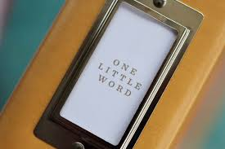
ONE WORD that will challenge your life
“Words are powerful. They have the power to inspire, encourage, appreciate, heal, and turn the impossible into the possible.”
Notes:
Perhaps skip this video depending on time! How many of you have set up a new years resolution in the past 5 years? How many of you have broken it? Guilty as charged…I don’t get very far with mine and when I set goals, I usually forget them. This short video will explain a little better than I can what the one Word process is.

Slide 10
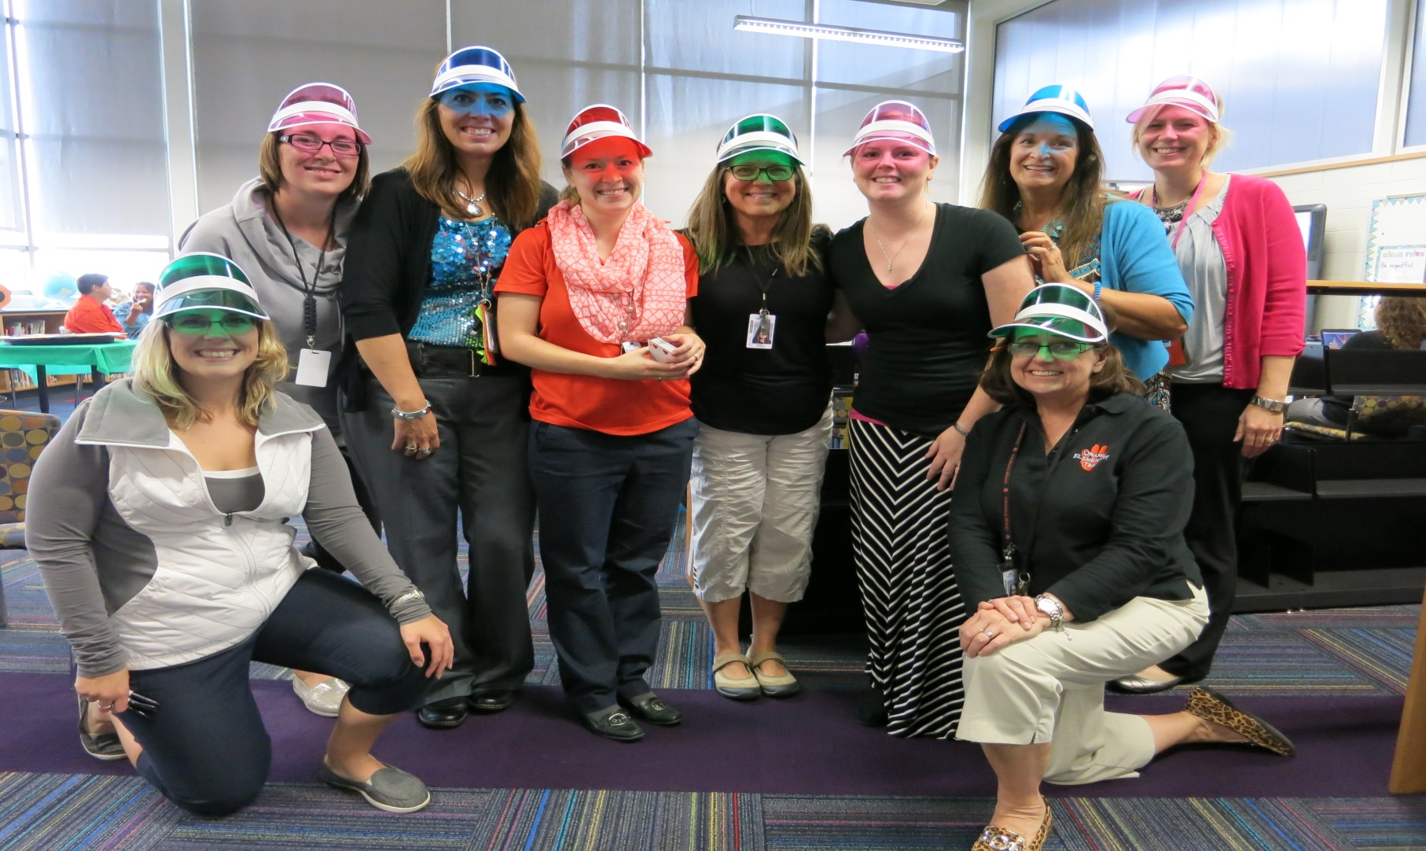
Stretch Team
“Your stretch team will fan the flames of impact.”
Notes:
How many of you still meet with your accountability partner from last year? I know the year has gotten away from us and we may not be meeting with our accountability partners regularly or some have moved away. I would like each of you to pick an area that you think you need to work on or be thinking about that area according to the 4 dimensions. At the end of the presentation we will do a quick activity where we will get new accountability partners.

Slide 11
The 6 Dimensions
Spiritual Impact
Physical Impact
Emotional Impact
Relational Impact
Mental Impact
Financial Impact
Notes:
As your One word makes its way into your life. The concept will have a powerful impact in these areas.

Slide 12
How?
Prepare your heart by looking in.
Discover your heart by looking up.
Live your word by looking out.
Notes:
So…how do I get started and find my One Word? Or should I say to allow your word to find you. Once you have found your One Word it will have a profound impact in your life.

Slide 13
Prepare your heart by looking in…
The Silent Killer
Busyness
Chinese word is made of 2 characters of a heart and killer
Escape the busyness of life and look inward.
What you sow, you will reap. What you invest into this process, you will receive in return. The seeds you plant today will create the harvest you will enjoy tomorrow.
Time?
How long will this take?
1)Unplug 2)Ask
Notes:
Failing to prepare=preparing to fail
The Silent killer is busyness-2 characters in chinese language shows heart and killing…busyness is a disease robbing us of life.
Time: There is no answer to how long it will take for you to discover your one word, you might find it right away, you might need a few days, you might take a few months to prepare. You start by unplugging which means intentionally finding solitude and silence. Once you have completely unplugged you will begin to see things more clearly and enjoy a peace that you never thought was possible. Ask:

Slide 14
Prepare your heart by looking in…
Unplug
Intentionally finding solitude and silence
No TV, music, computer, phone, other people, to-do lists
“A word with power is a word that comes out of silence.”
Ask
What do I need?
What’s in my way?
What needs to go?
“The why is always more important than the what.”

Slide 15
Looking up…
You are ready to receive your word.
Plug in
Making time for prayer
Ask God to take control-You don’t have to create your own word. God has a word for you. (personal story)
“What do you want to do in me and through me?”
Receiving the word that is meant for you to live and share with others.
Listen up
It’s important to listen to God-It is easier to talk than it is to listen to him.
There is no telling how your word will be revealed to you or when-but listen and watch for signs from God.
Notes:
I will admit, the looking in part was easier for me to do than this next part. Now you receive your word. I say receive because the authors of this book mentioned how when you pray and totally give control to God, he will give you your word, you do not necessarily pick it.
The reason why I put personal story up here, is because after reading this book and following the process I had a very inspirational moment/moments. Like I said I struggle with the prayer aspect but have continued to work on it. Gong into my prayer I had a list of words that I was pretty positive I needed to work on. Determination, motivation, strong, focus…So these are going through my head as I am asking God this question: What do you want to do in me and through me? I was waiting for one of these words to just scream out so that I knew that was the one. Instead, the word LOVE popped into my head. I was surprised and definitely doubting. Within the next few days after going to church and reading some books and taking 5 hours away from the world…I realized that LOVE is my word. It surprised me because I thought…I’m a loving person, I feel as if I show it to everyone around me. Then I looked up the definition of love and realized that I really need help in that area. I believe that I received the word rather than picking the word.

Slide 16
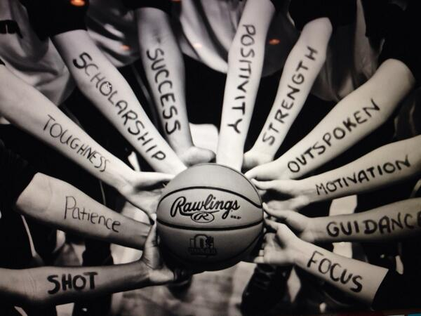
Live your word: Look out…
When your word comes to you it may come in the form of a character trait, a discipline, a person, a spiritual focus, an attribute, or a value.

Slide 17
Live your word: Look out…
Live it out
Look out and you’ll begin to see opportunities all around you.
Step outside of your comfort zone
It may seem easy at first, but you will be stretched and challenged.
“Keep your word front and center.”
Post in prominent places so you see it regularly.
Own it. Personalize it. Internalize it.
Notes:
Once I found my word, all I saw were opportunities to use my word in action ‘the right way.’ Every book I read, song I heard, it was everywhere! I believe that Melissa Vance told me yesterday that Al Roker from Today show’s word is open. He is willing to step outside of his comfort zone.

Slide 18
Live your word: Look out…
Sticky notes
Screen saver
Background on phone
Paint a picture
Artwork
Journal-insights/lessons
Start with family
A challenge a week
Sayings or quotes
Songs
Poems or prayers
Tattoo

Slide 19
Don’t forget your stretch team!
Share your own word with them so that they can motivate, encourage, challenge, and celebrate with you!
Give them permission to ask you about this word and keep you accountable.
Notes:
Accountability activity? If Time? Do we have them write down their partner and word?

Slide 20
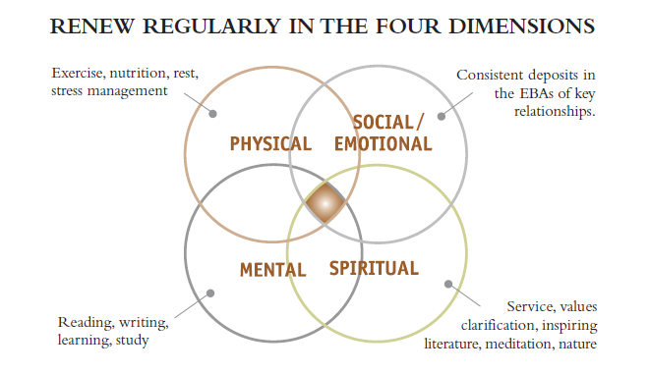
4 Dimensions

Slide 21
The importance:
To-do vs To-be
Success is often measured by what we have accomplished instead of who we have become.
80th Birthday
Leaving a lasting legacy and making a mark happens when you live out your word/mission statement each year.
Your word/statement shapes your character. Your character influences your actions. Your actions influence others. The lives you touch and the impact you have determine the story that will be told about you tomorrow.
Notes:
When you are 80, would you rather be recognized by what you have accomplished or who YOU are?

Slide 22
“Don’t check the box; experience the journey.”
Notes:
Life is not a to-do list…but more so a to-be list.

Slide 23
This is your life: Make it a Masterpiece
What do you want others to remember you by?
Notes:
1:38

Slide 24
Agenda
Melissa H
PBIS data
Melissa V
CICO
Megan
Accountability Partners
Time to meet and chat with accountabili’buddy’!

Slide 25
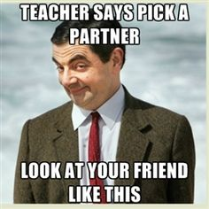
Accountability Partners
“Ask yourself if what you are doing today is getting you closer to where you want to be tomorrow.”

Slide 26
Accountabilibuddies
Who:
One of the fastest ways to bring accountability to your life is to find an accountability partner!
Mentor, peer, co-worker, coach, family
Why:
Written goals- 39.5% more likely to succeed
Written goals and progress reports: 75.7% more likely to achieve their goals
As effective as writing down your goals can be, simply sharing your progress toward your goals with someone regularly, even just a friend, makes you almost twice as effective! Accountability works!
Dr. Gail Matthew’s Research

Slide 27
We go together like…

Slide 28
LEAD time
Goal: LEAD time is a time that teachers will set aside and focus on leadership skills and the 7 habits in order to create strong leaders within our students!
15 minutes
One topic a week planned by action teams (schedule)
Adaptable content within the topic
Bulletin board in commons as a reminder for students!
How is it going?
Ideas on how we can improve?

Slide 29
Home Connection
Goal: Home connection is a chance for parents and kids to work together and use the 7 habits at home.
Once a month
Lighthouse team
Home Connection Wall
This weeks: Family Mission Statement

